Slide 1
Detecting “clickbait” headlines
Vince velocci
December 13, 2016

Slide 2
MOTIVATION
Clickbait: A headline for an article that entices you to click, but which contains less news value. Used to generate ad revenue.
Such articles can be entertaining to read, but what if you’re busy and want to filter them out temporarily?

Slide 3
MOTIVATION
This would be a great task for Natural Language Processing!

Slide 4
Odd/even article list length vs frequency
Odds more prevalent than evens
Odd number at start of headline chosen as model feature
21

Slide 5
Data & model
DATA
Scrape/API headlines from:
31000 headlines chosen from each class
MODEL
TF-IDF Vectorizer with numbers 1-1000 among default stop words. “You”, “Your”, “What”, “Which” were NOT.
Logistic Regression:
95% Accuracy
93% Recall
96% Precision
0.986 AUC
Evaluated on Test Set
Balanced Classes

Slide 6
Top Predictive model features
POSITIVE
You
Your
People
Which
Dog
Adorable
Hilarious
Everyone
Beautiful
Amazing
Something
NEGATIVE
Review
China
Says
Oil
Market
CEO
Profit
Deal
Bank
Case
California

Slide 7
TOOLS USED

Slide 8
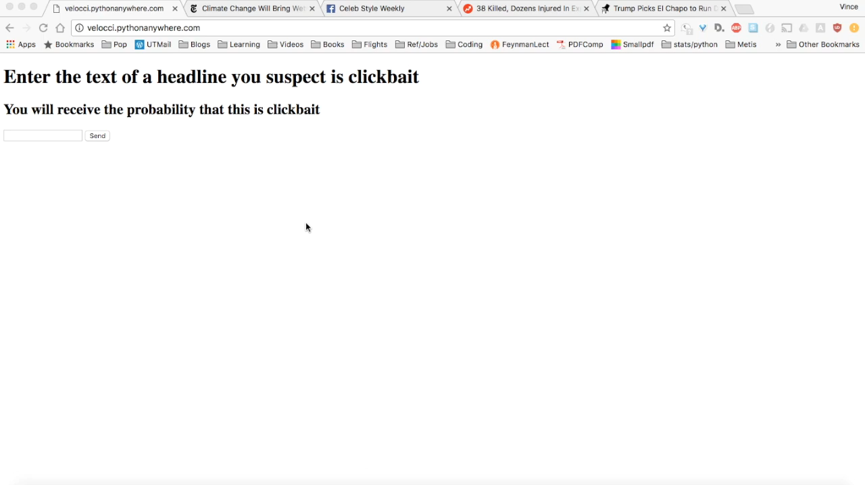
Web app demo @ velocci . pythonanywhere . com

Slide 9
Conclusions
Logistic Regression does a pretty good job at classifying clickbait headlines
‘You’ in a headline seems to be a good indicator that it’s clickbait
Satire, apparently, is NOT clickbait, according to the model (Success?)
Test headlines at velocci.pythonanywhere.com

Slide 10
Thank you!
Vince Velocci
velocci@utexas.edu
github.com/unif2
www.linkedin.com/in/vince-velocci

